Slide 1

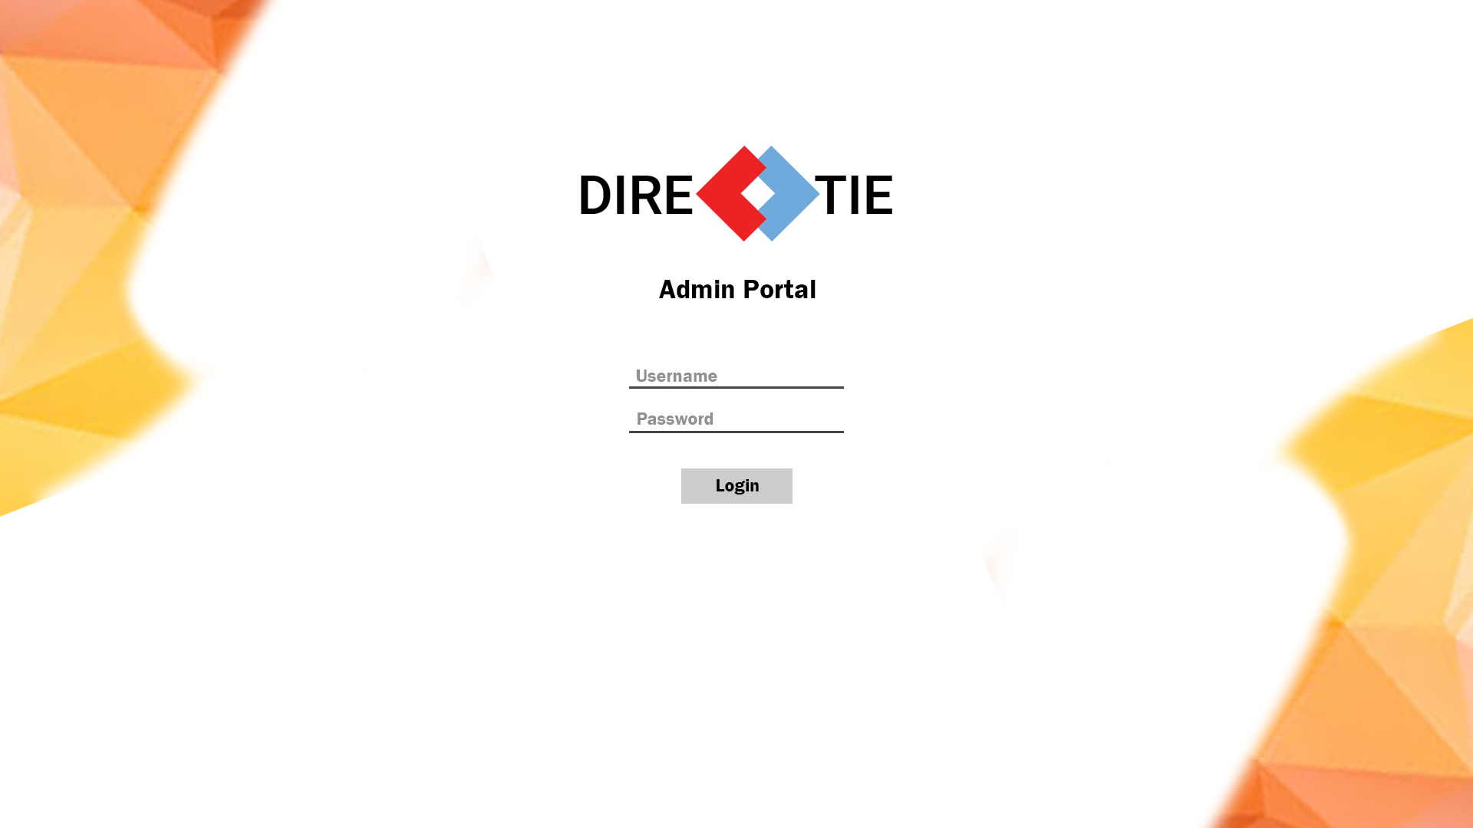


DIRECTIE
Presented by:
Chua Wei
Chia Kwee Cheng
Ng Hong Yao
Garick Chong Jun Kang
Tay Wei Sern

Slide 2
Outline
Problem Statement
Objective
Proposed Solution
System Architect
Technologies Used
UI Design
Application Demonstration
Q&A

Slide 3
The Problem Statement
The visually impaired may be unfamiliar with the environment and thus, get lost easily. Although there are helpers to guide them around, they may not be always there.

Slide 4

Objective
Assist the Visually Impaired in navigation within an indoor environment through a mobile application.

Slide 5


Slide 6
Main Features (Front-End)
User Login & Registration (Directie User, Facebook, Google)
Detect User’s location
Routing of shortest path to Destination
Speech Navigation
View, Edit User Profile

Slide 7
Main Features (Back-End)
Manage Beacons
Manage Relation Beacons
Manage Beacon Directions
Manage Facilities
Manage Units
Manage Users

Slide 8

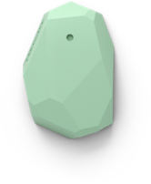




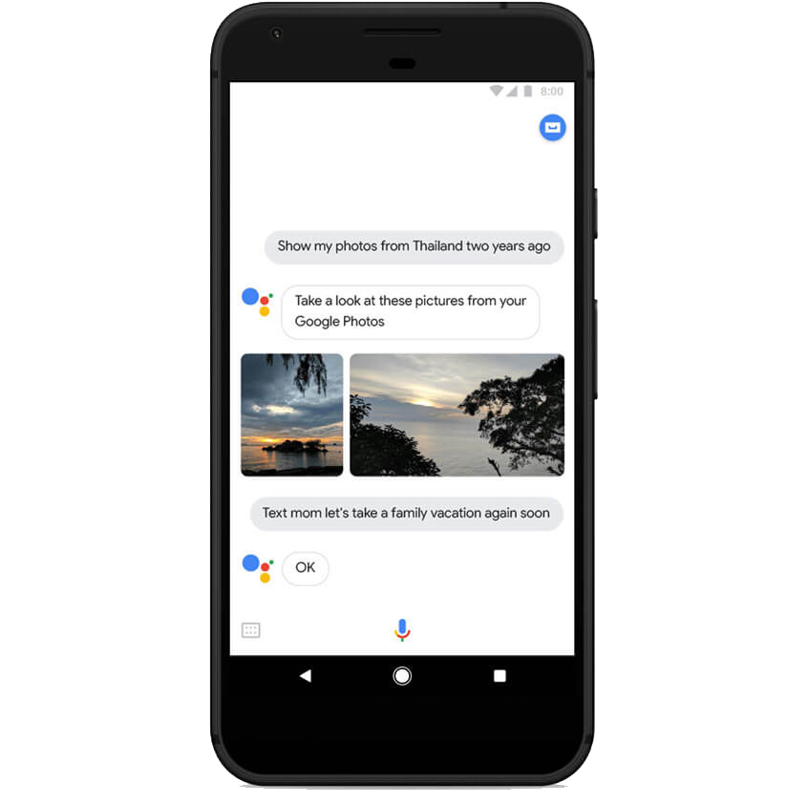

Proposed Solution
[Current Location:
T2138]
[Direction:
Turn right,
Advice:
Push door to open]
[Direction:
Go straight]
Toilet

Slide 9
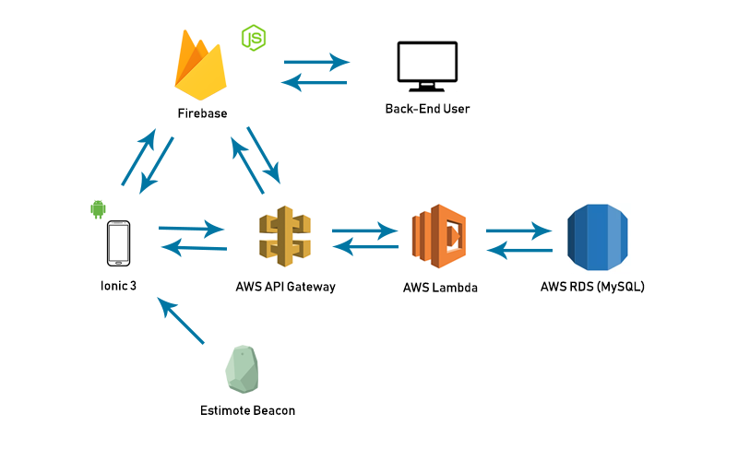
System Architecture

Slide 10
Technologies Used
Firebase
Node.js
Ionic 3
Amazon Web Services (AWS Lambda, Api Gateway and RDS)

Slide 11
Why Firebase?
Real-time Database
Hosting free of charge
Provides external login authentication

Slide 12
What’s so good about Node.js?
Asynchronous programming
Only relies on javascript

Slide 13
What is Ionic?
HTML5 mobile app development framework
Built on angular
Used to build hybrid mobile applications

Slide 14
Why choose Ionic?
Cross-platform
Development Tools
Completely free and open source
Support for many plugins

Slide 15

Amazon Web Services
Reasons for choosing AWS :
Cost effective ( Pay for what we use )
Security ( All data is stored in highly secure AWS data centers)
Scalable, high performance and flexible.

Slide 16



AWS API, Lambda and RDS
3 Services that our application uses
AWS API Gateway
AWS RDS
(mySQL)
AWS Lambda
Notes:
PROB STATEMENT
OBJECTIVE
NAME OF APP
main features
PRPOSED SOLUTION
SYS ARCHITECT
WHY CHOOSE IONIC/nodejs (tech use), aws
database design (never mention firebase)
WIREFRAMES
DEMOSTRATION

Slide 17


How AWS work in our application
Node.js
AWS API Gateway
AWS Lambda
AWS RDS
(mySQL)
Ionic 3

Slide 18
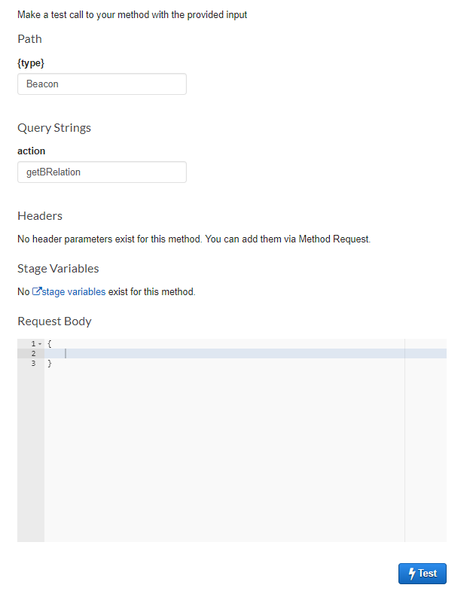
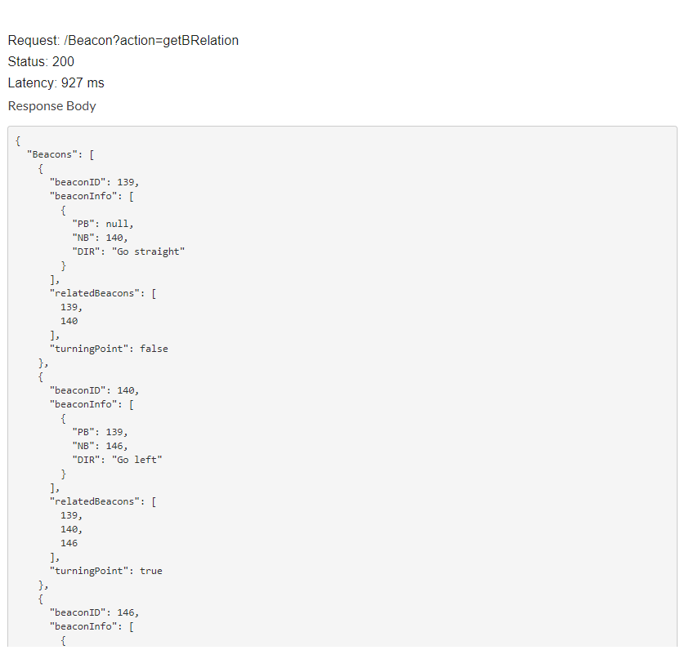
AWS Api
Gateway
Demo

Slide 19
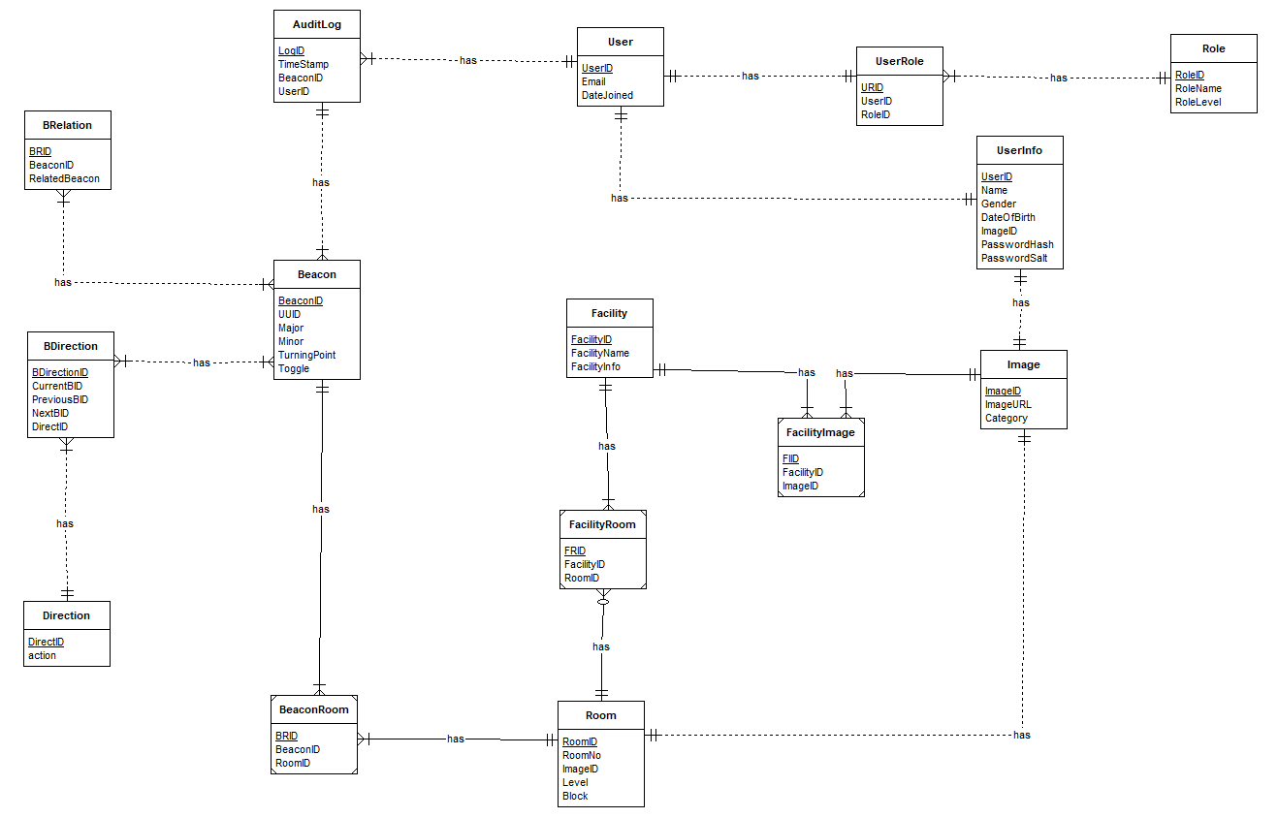

Slide 20
Why is the logo designed like this?
Why choose those colors?
Contrast between one another
Represents youth
Why choose arrows to replace ‘c’?
Signifies direction

Slide 21
Mobile Application
(Wireframes)

Slide 22

Splash Screen

Slide 23
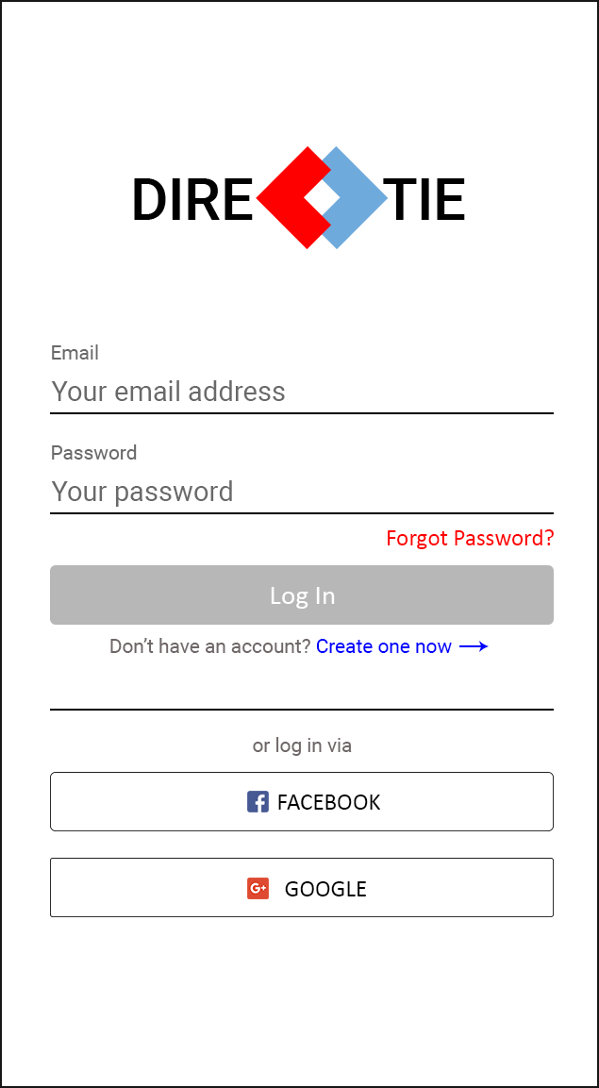
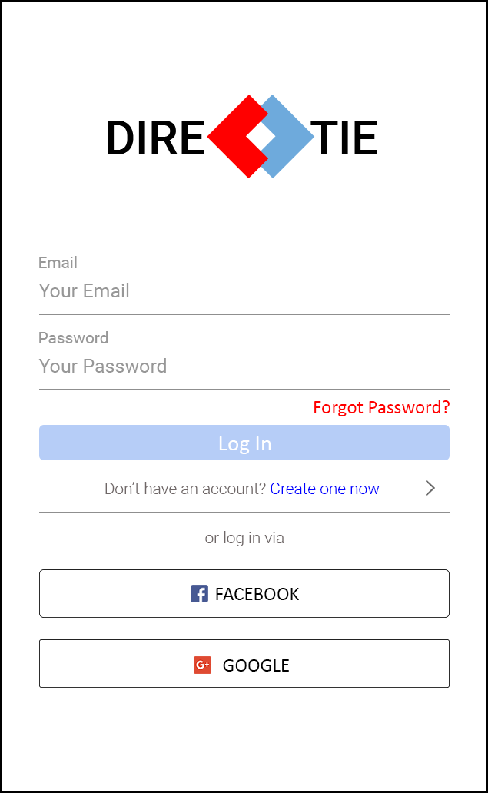
Login Screen

Slide 24
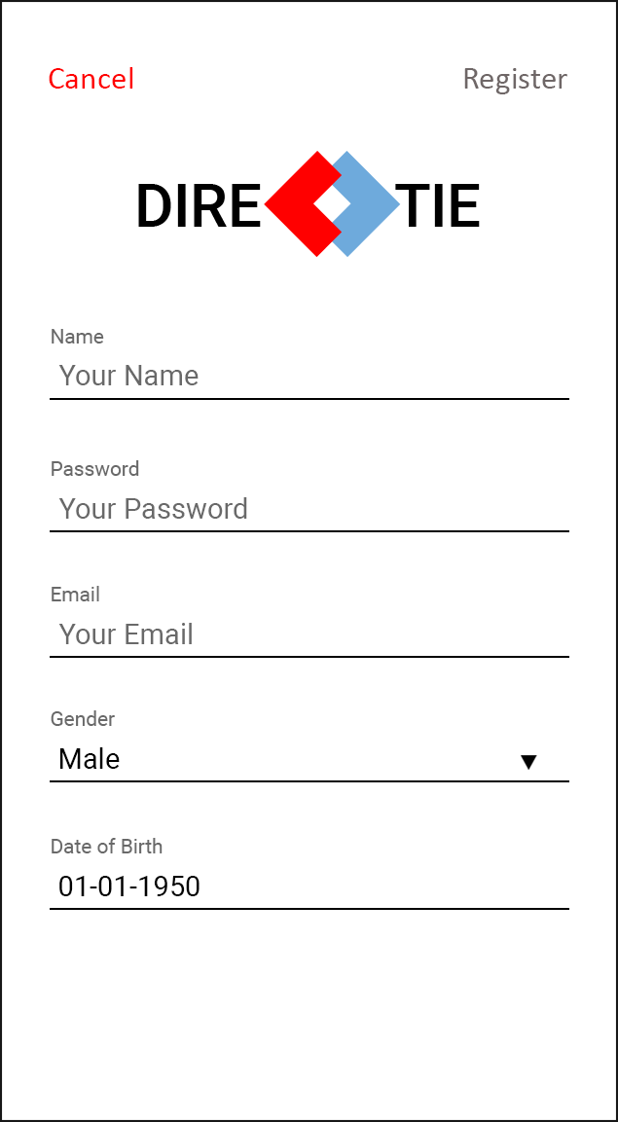
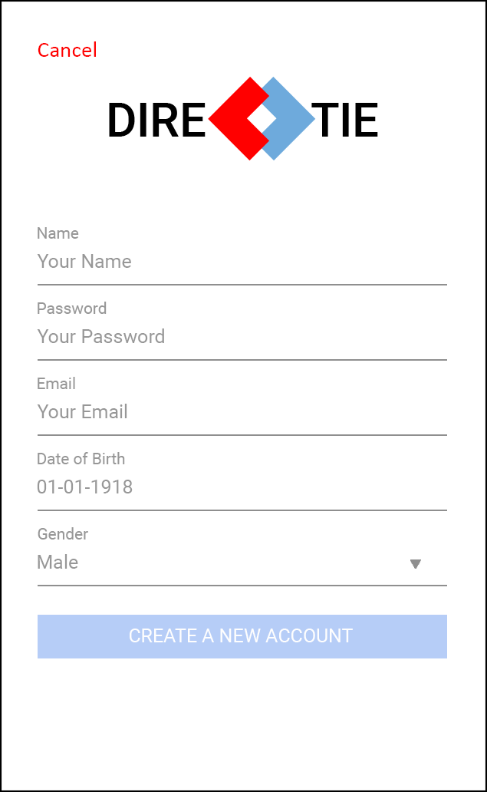
Register Screen

Slide 25
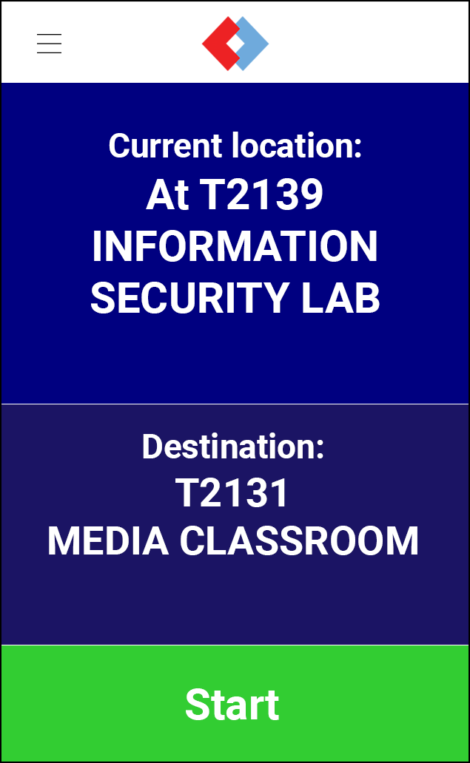
Home Screen

Slide 26
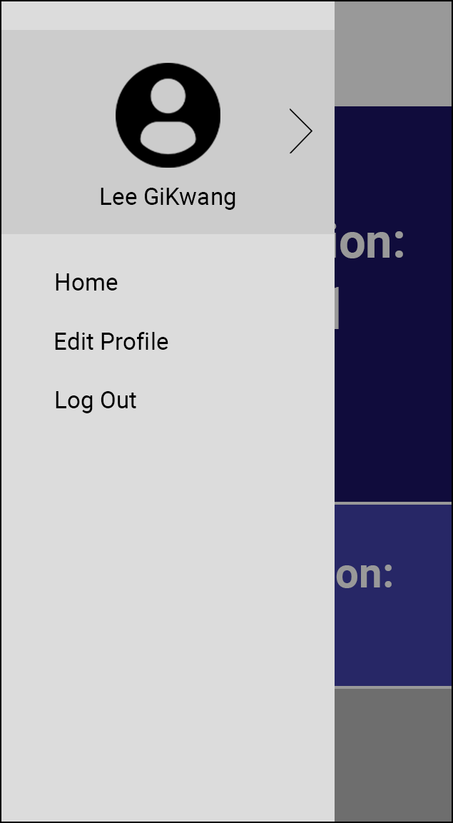
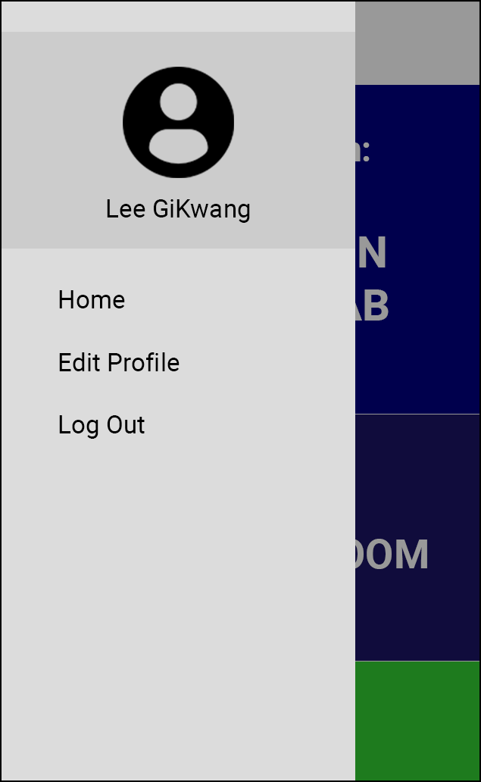
Side Menu

Slide 27
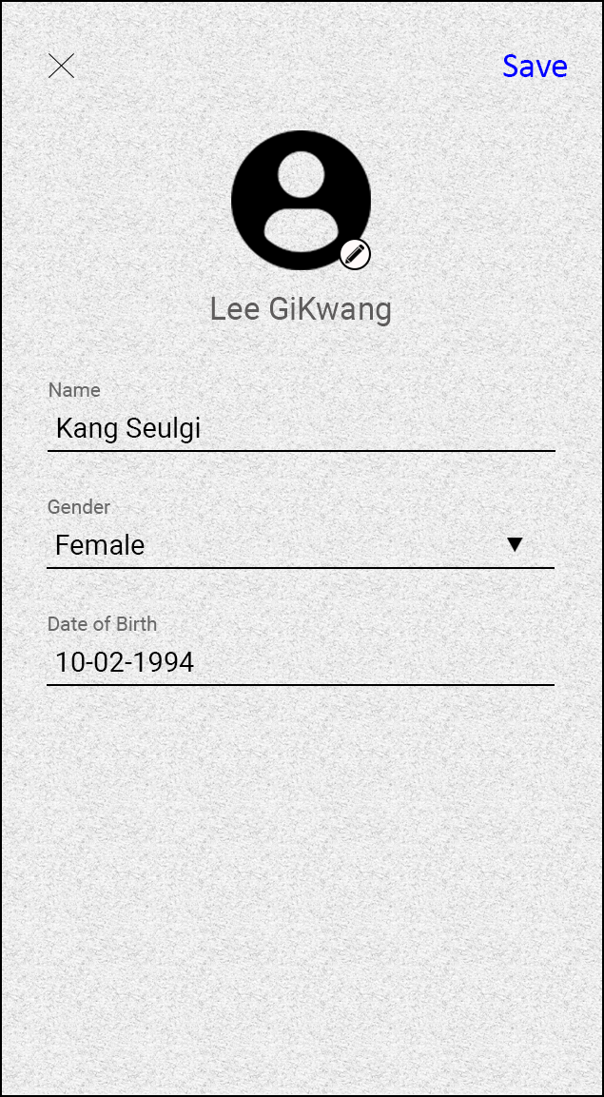
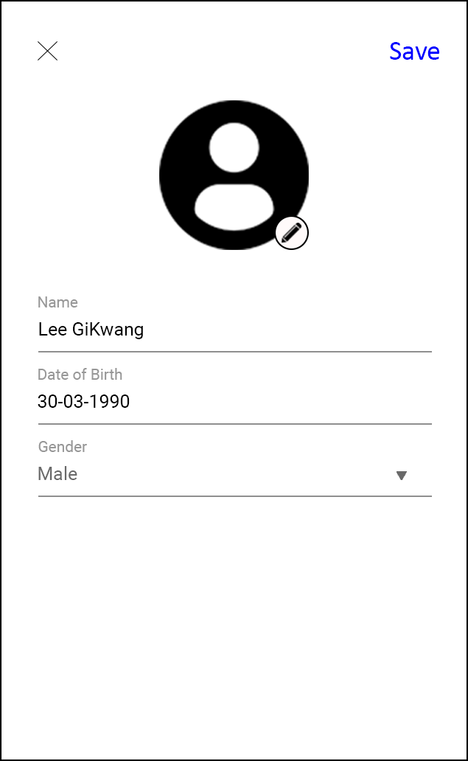
Edit Profile

Slide 28
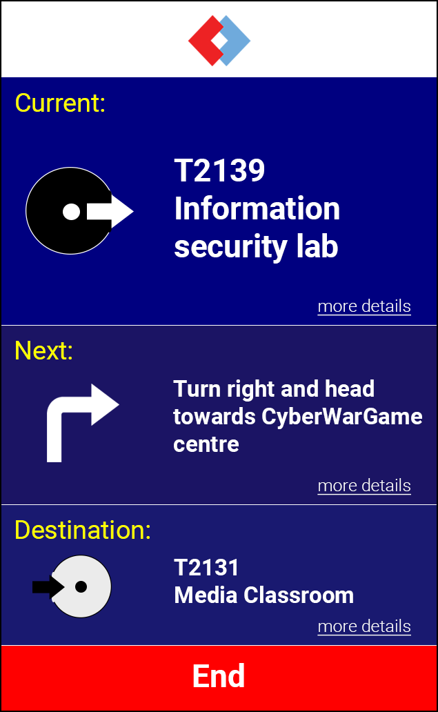
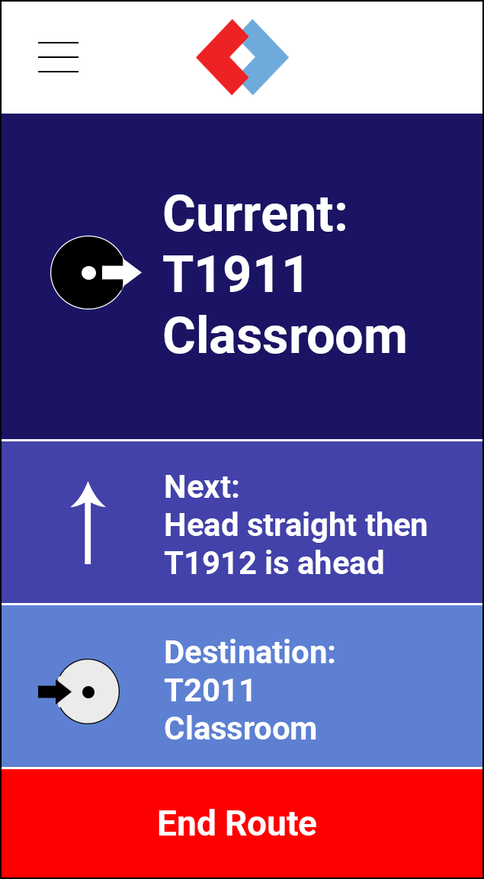
Navigation Screen

Slide 29
Admin Portal
(Wireframes)

Slide 30

Login

Slide 31
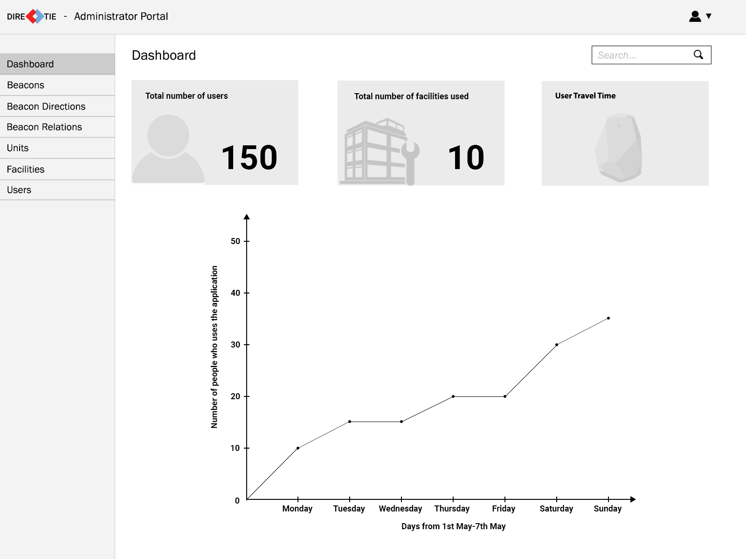
Dashboard

Slide 32
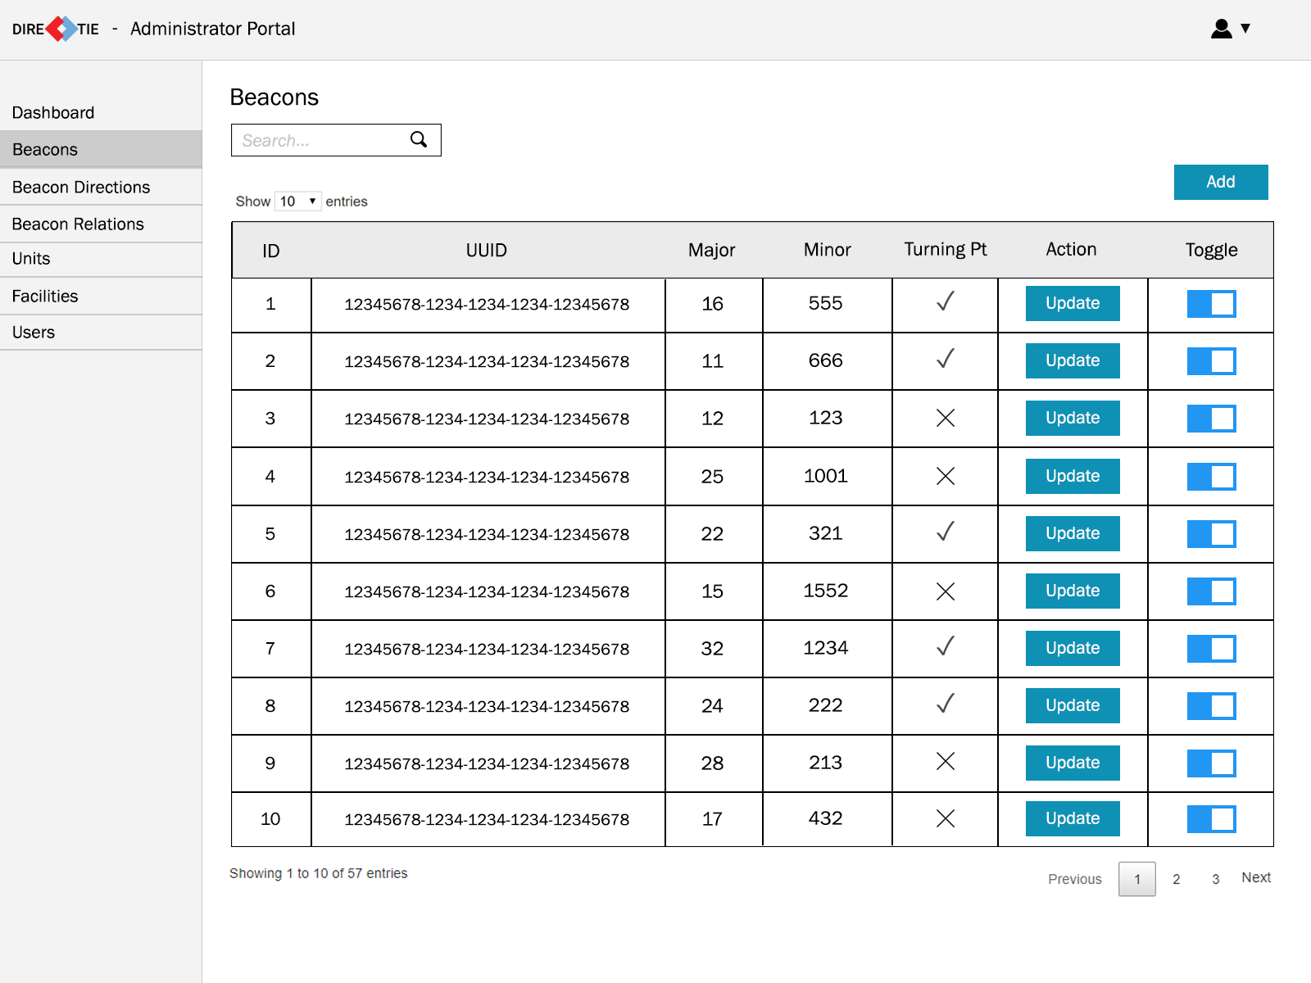
Beacons

Slide 33
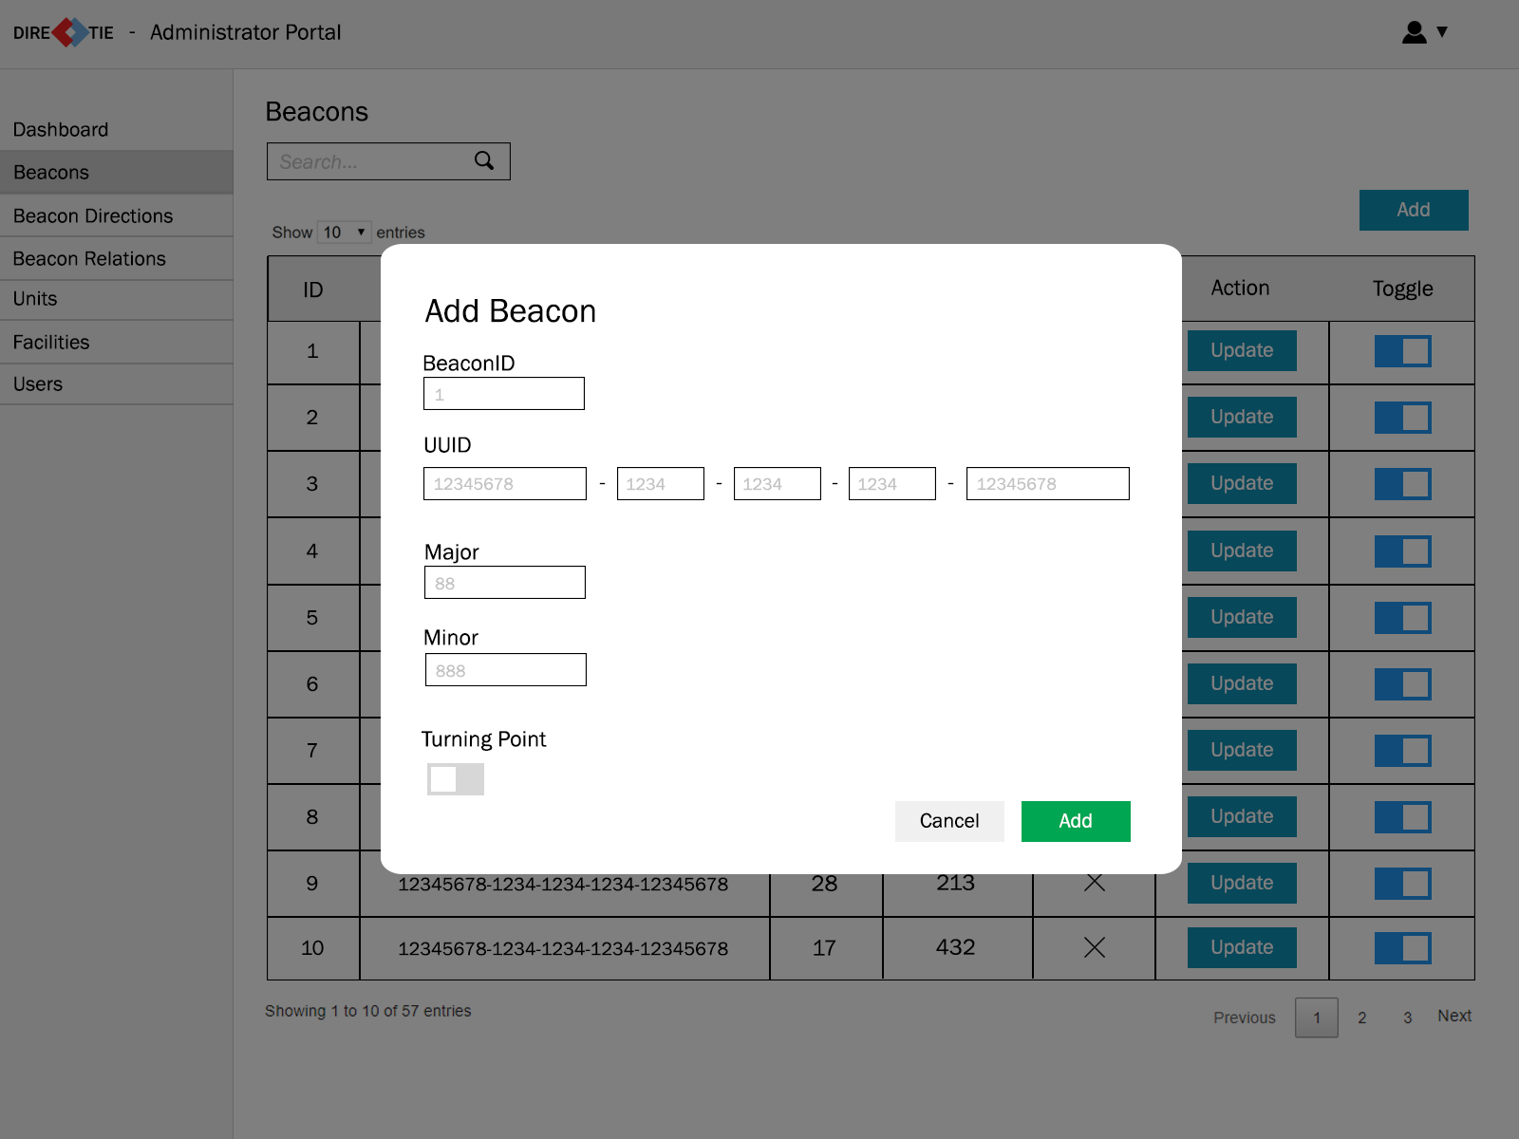
Add
Beacon

Slide 34
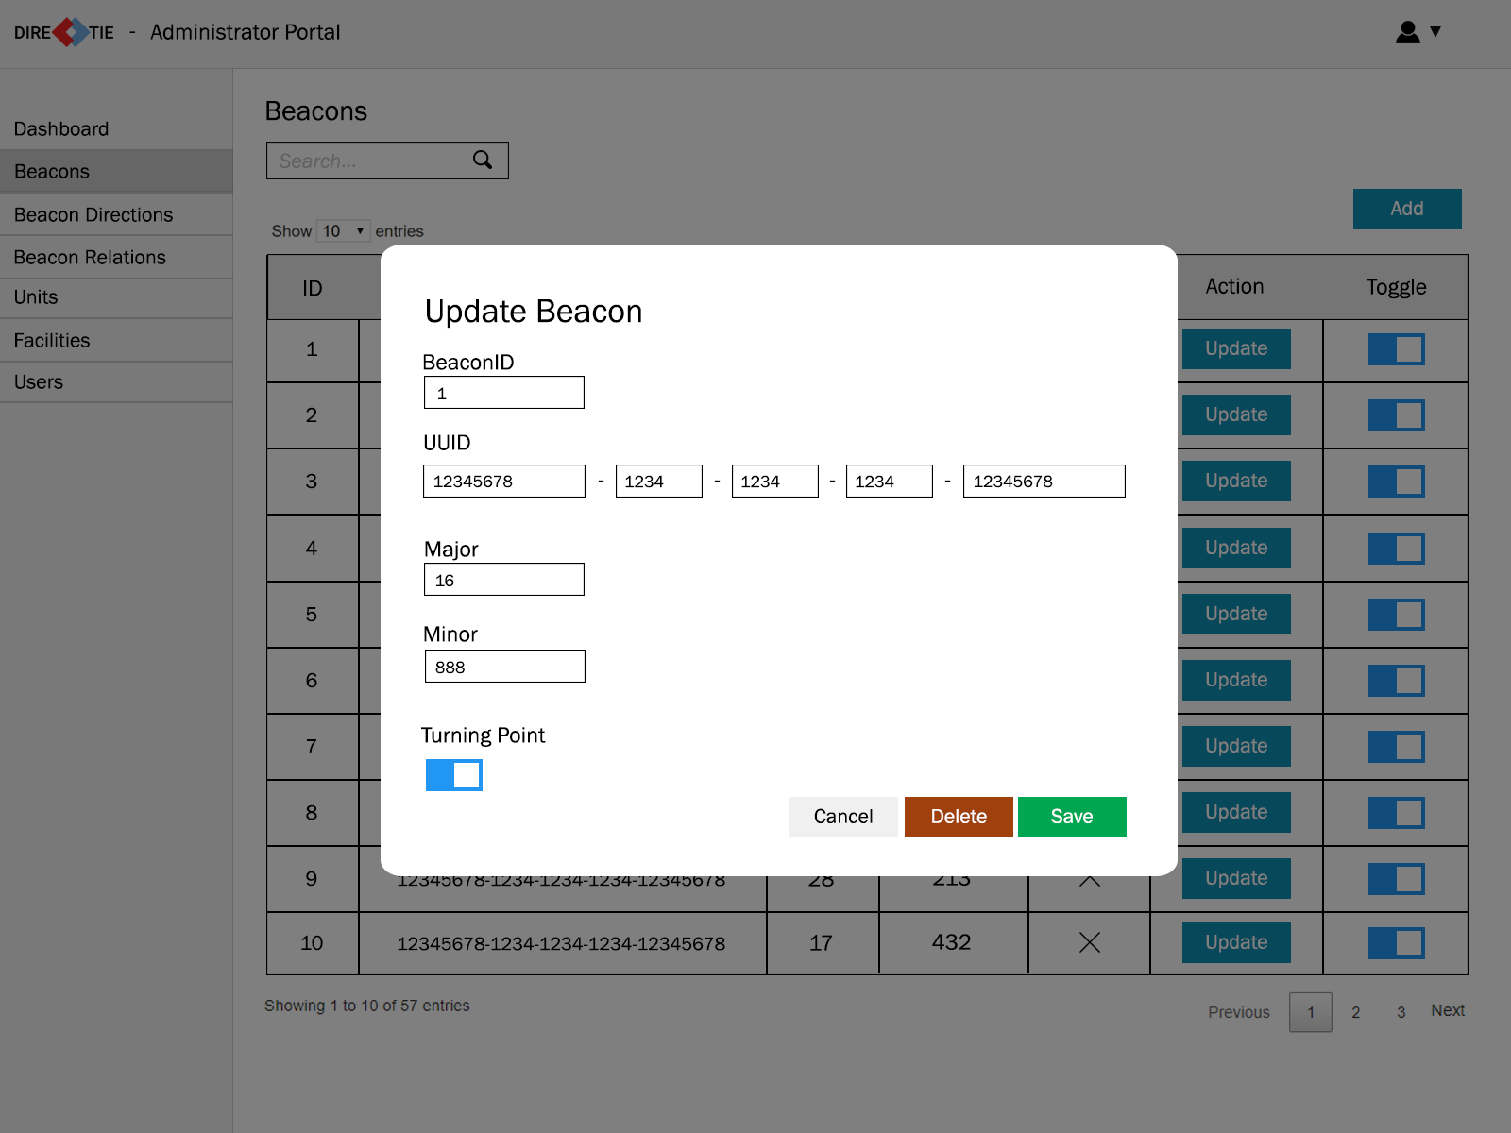
Update
Beacon

Slide 35
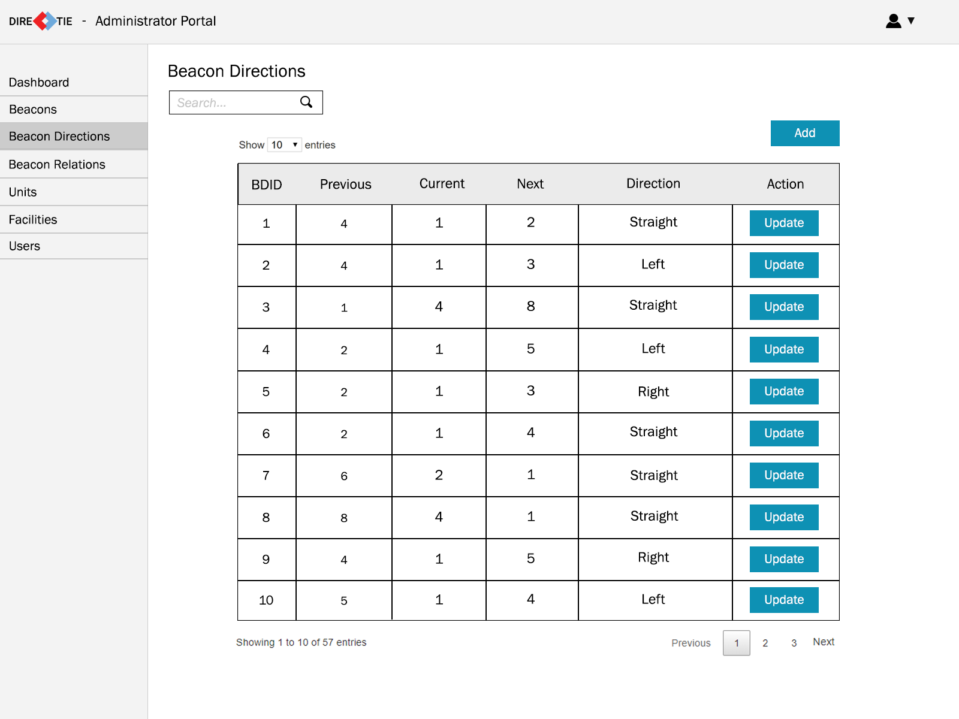
Beacon
Directions

Slide 36
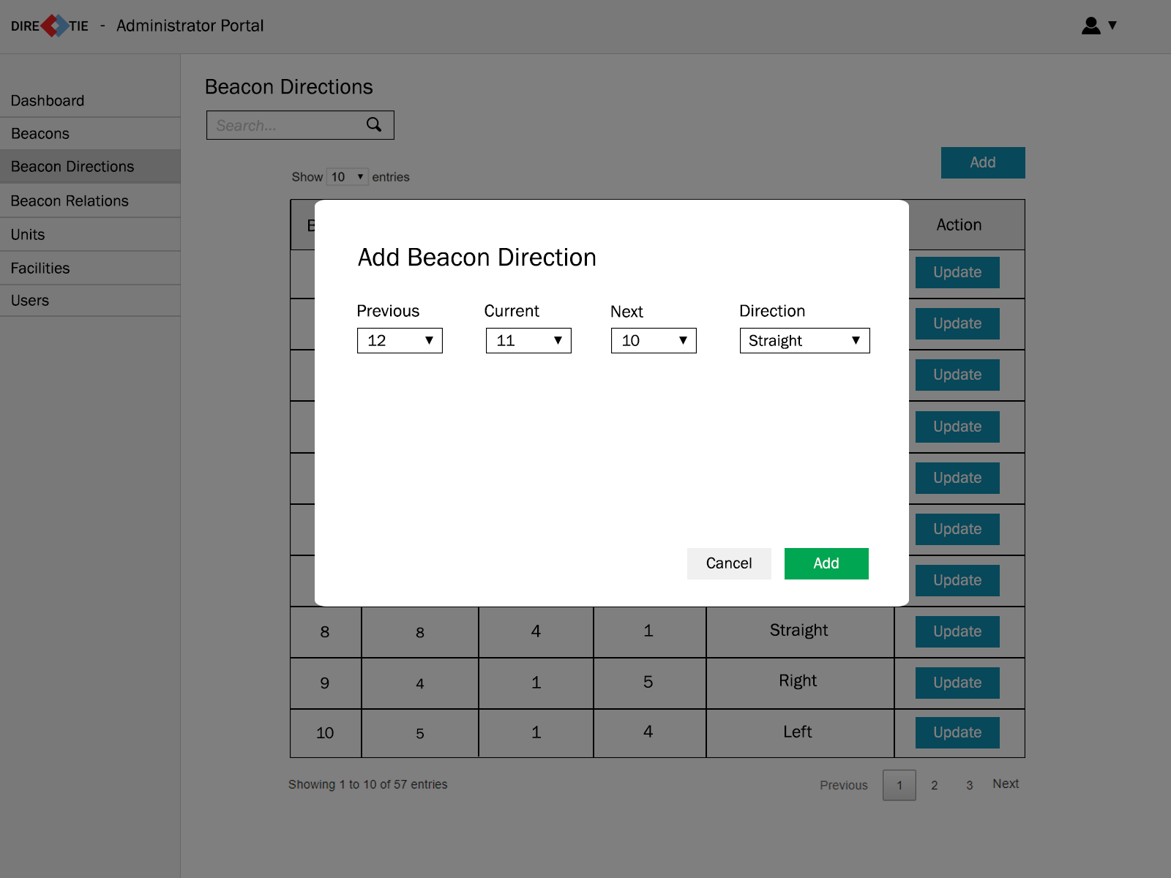
Add Beacon
Direction

Slide 37
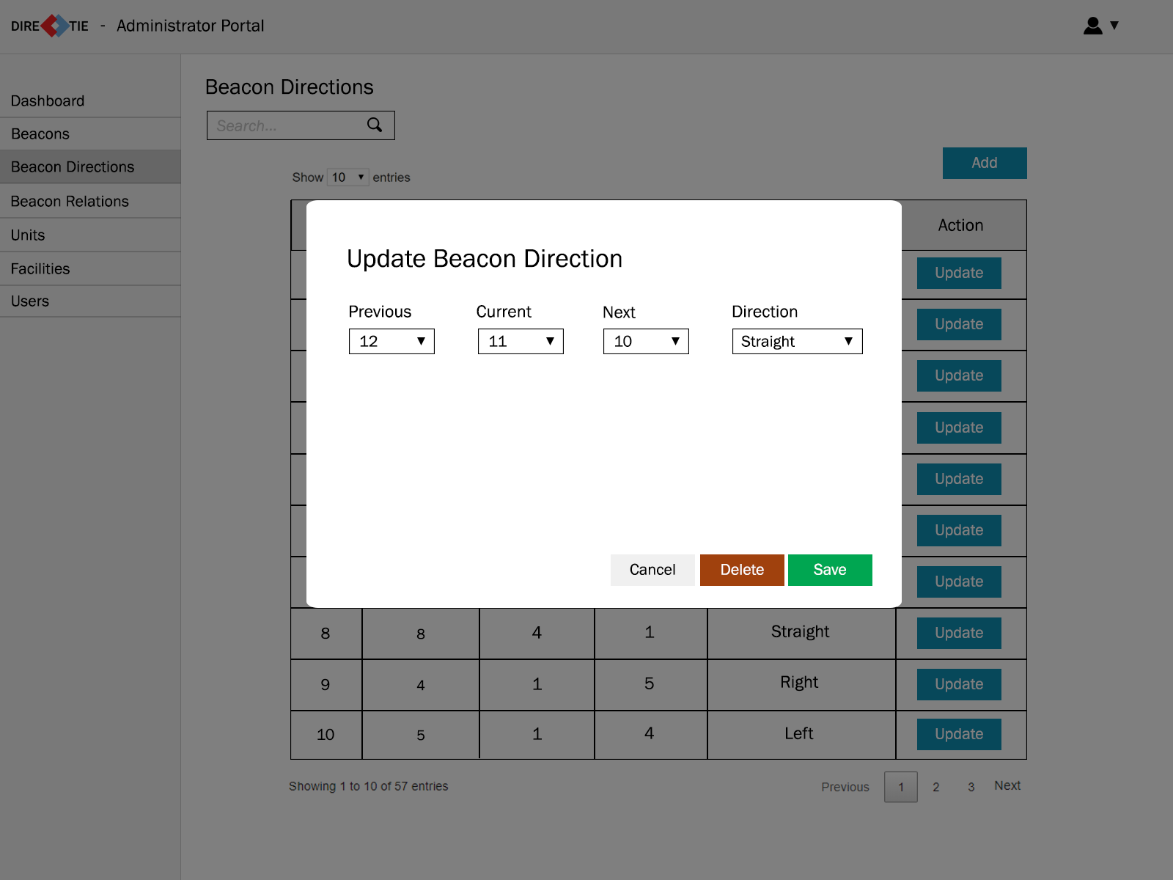
Update Beacon
Direction

Slide 38
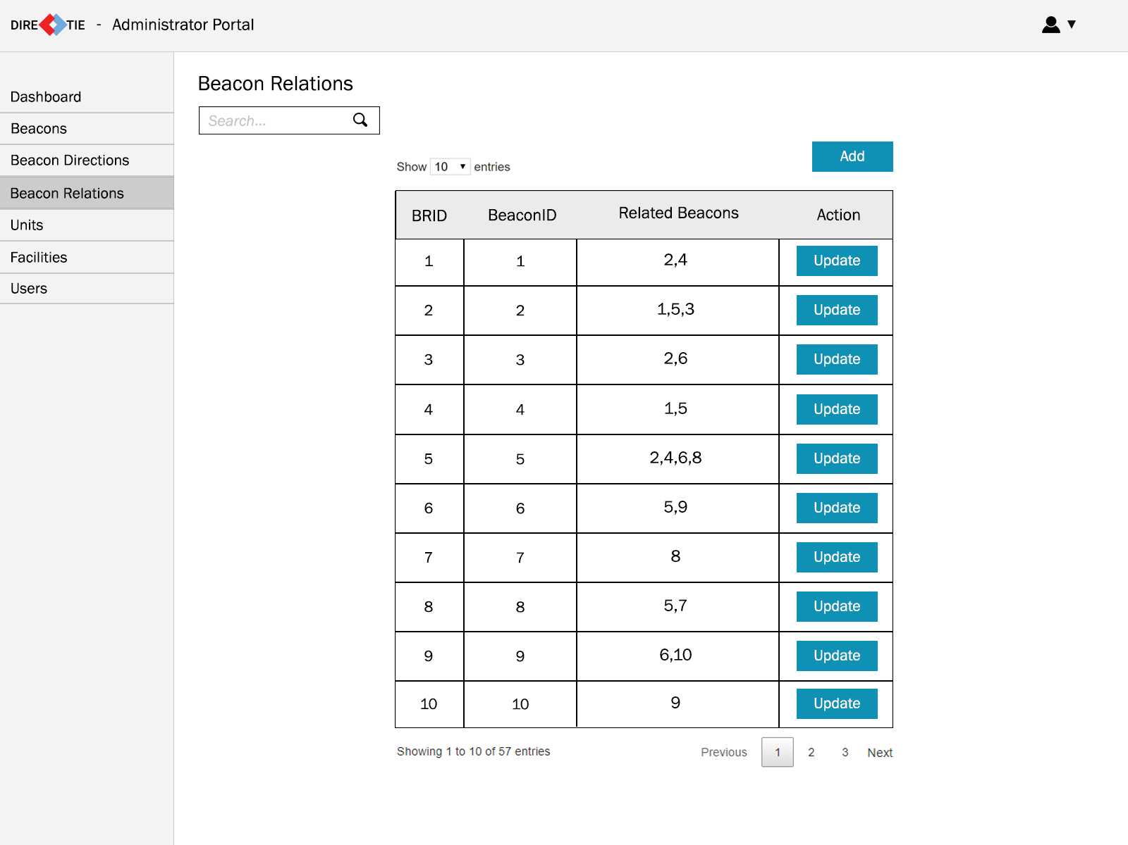
Beacon
Relations

Slide 39
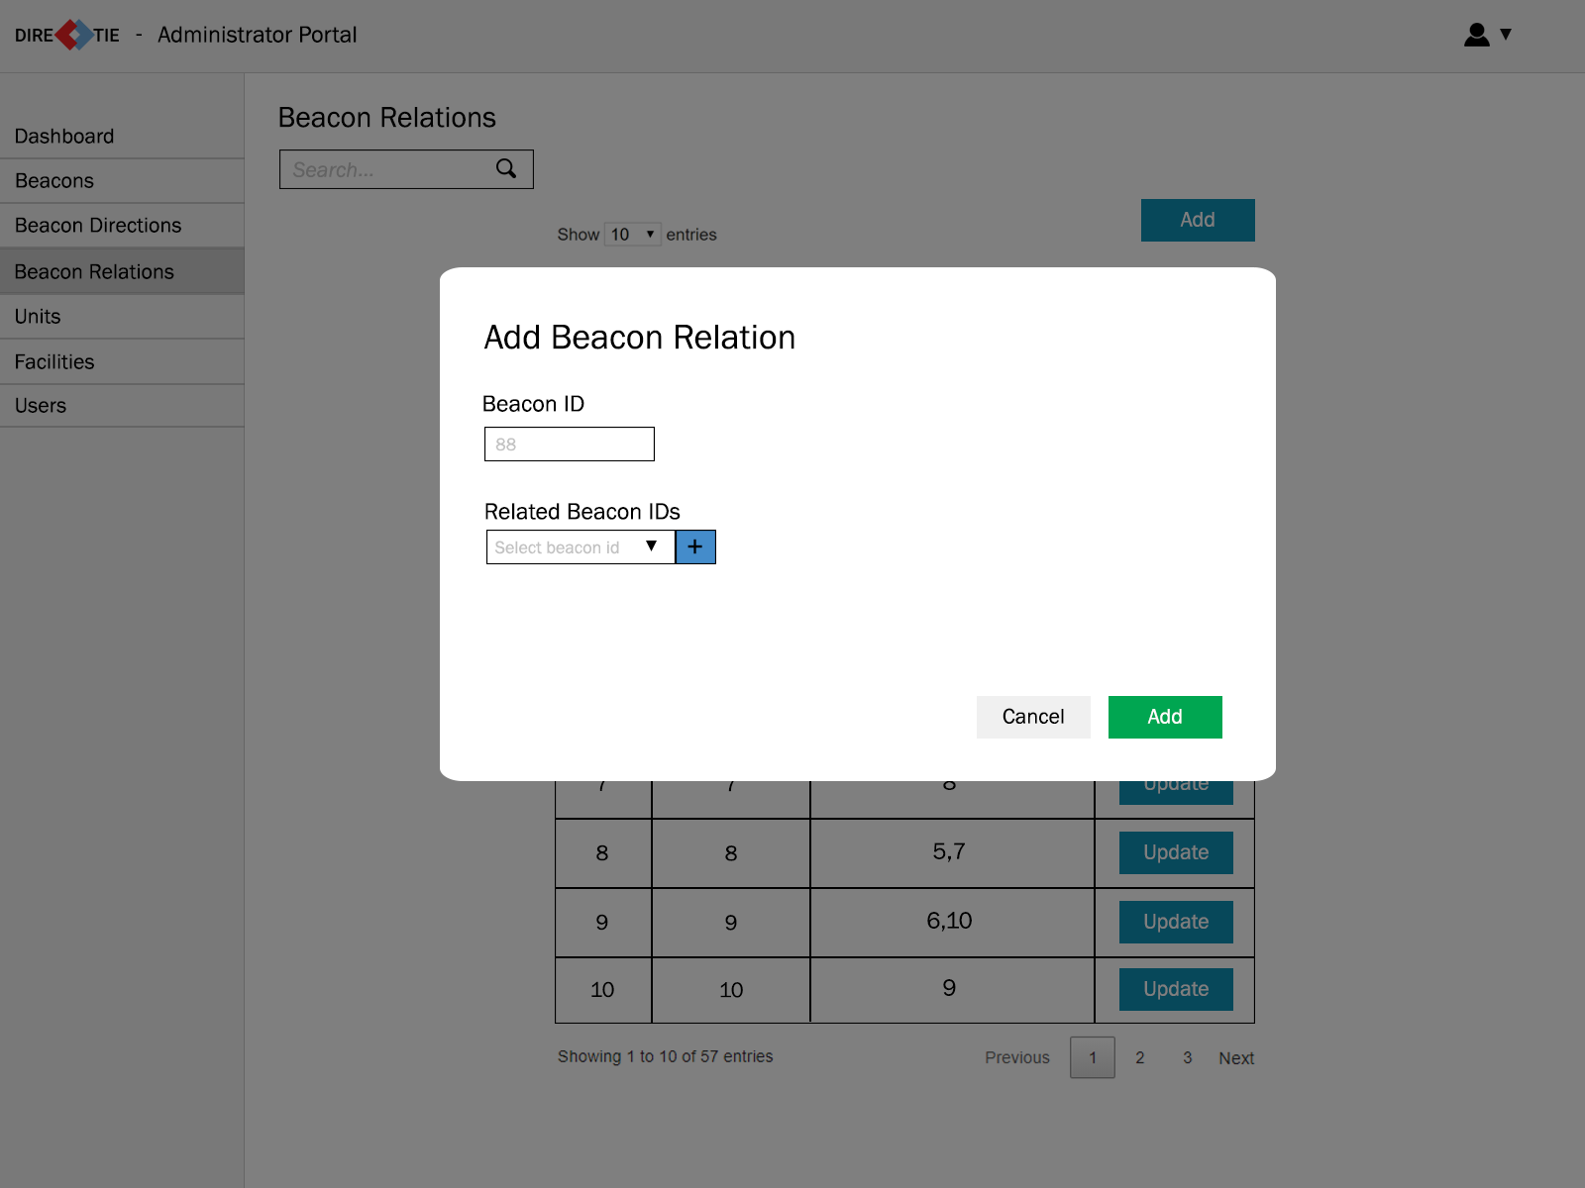
Add Beacon
Relation

Slide 40
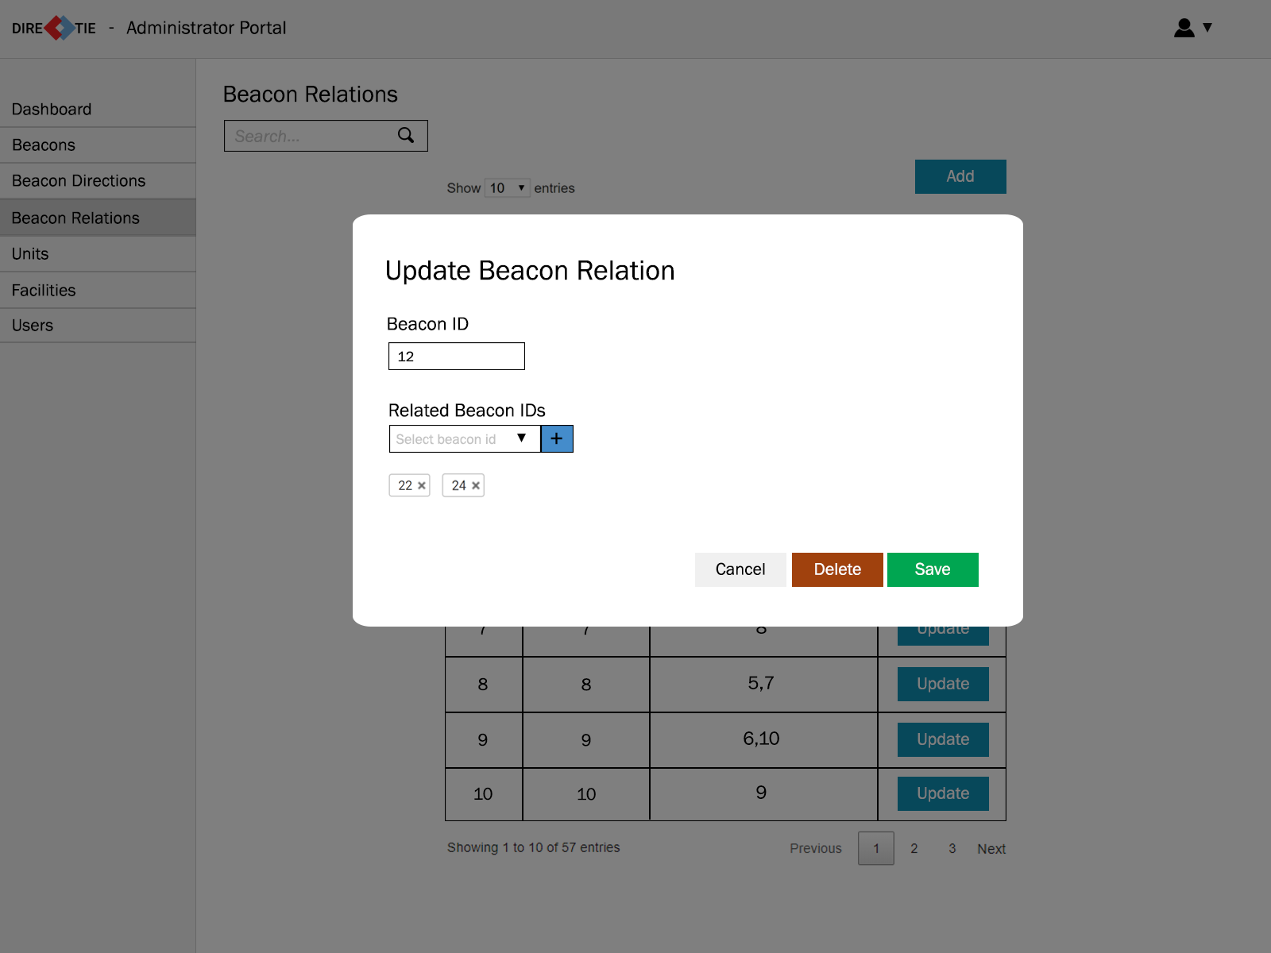
Update Beacon
Relation

Slide 41
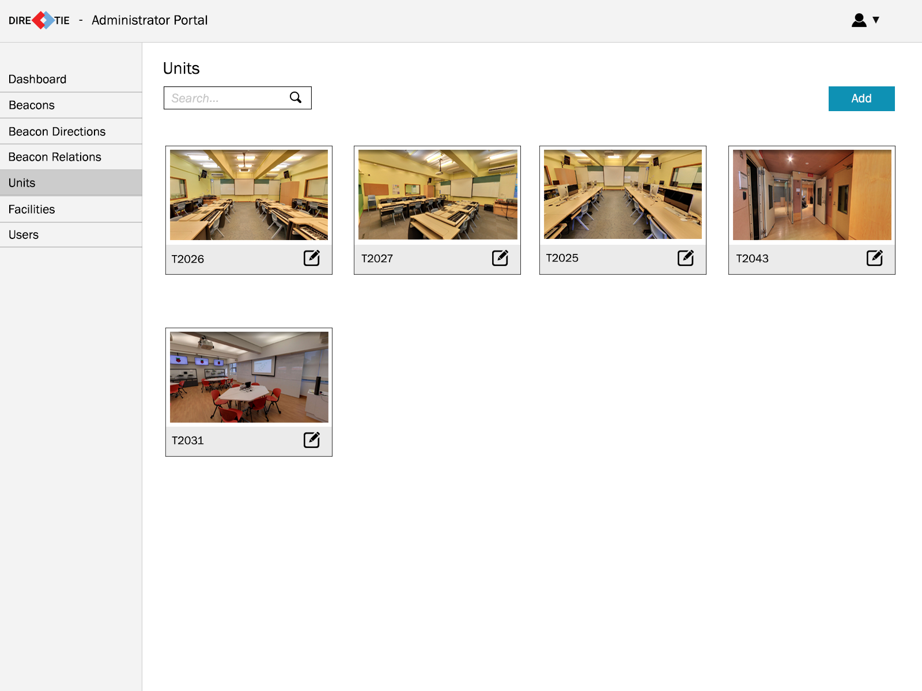
Units

Slide 42
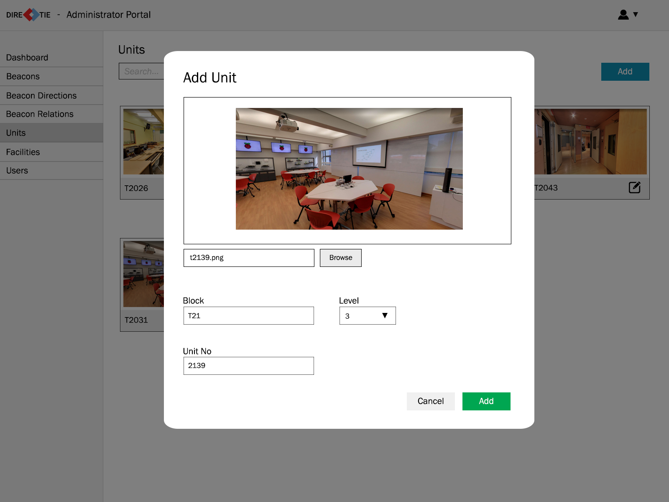
Add Unit

Slide 43
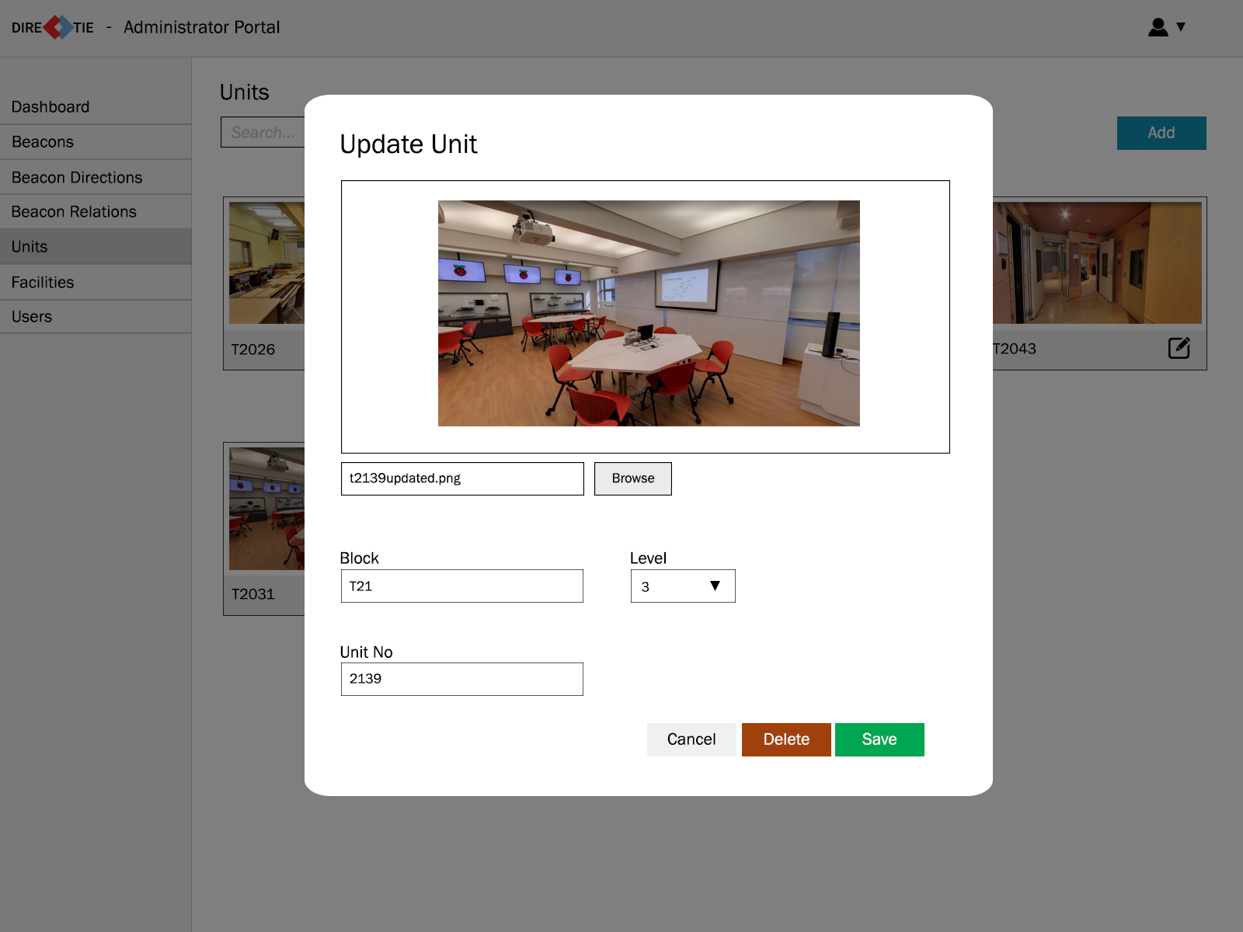
Update Unit

Slide 44
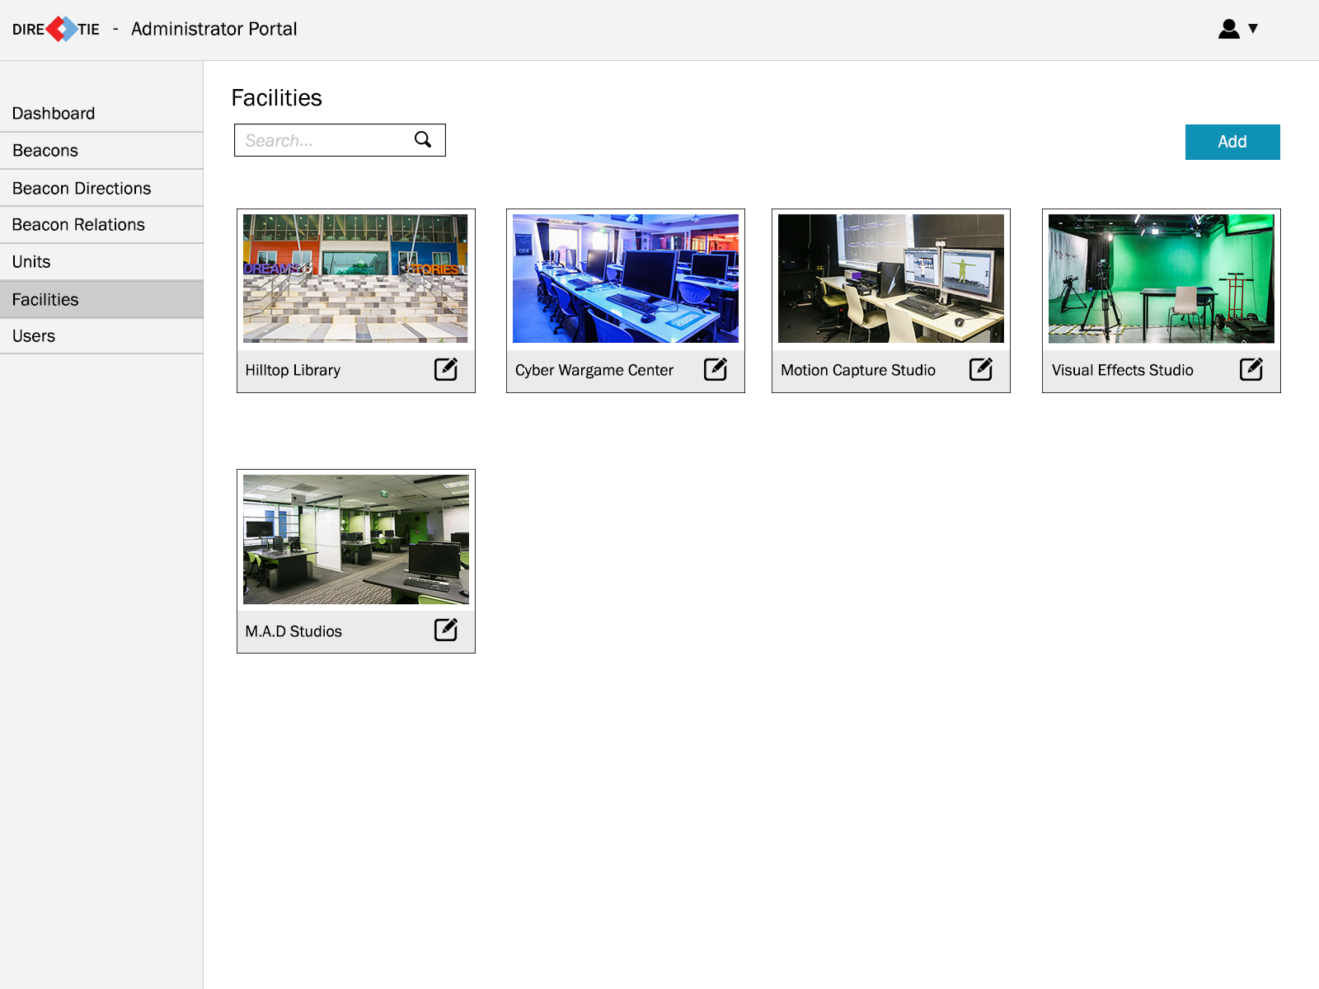
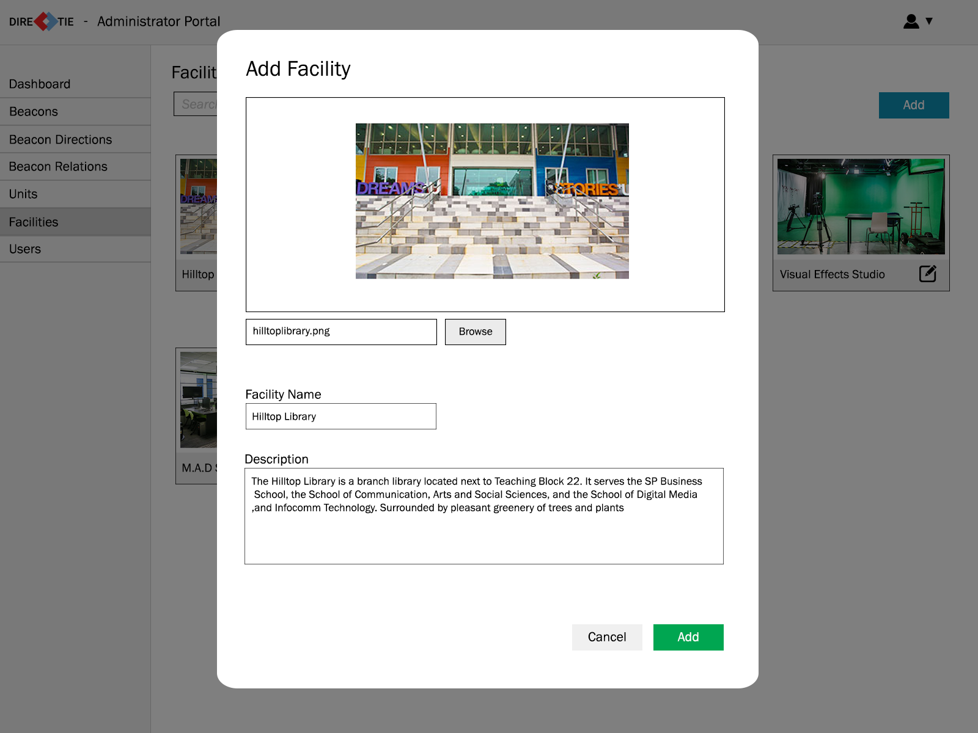
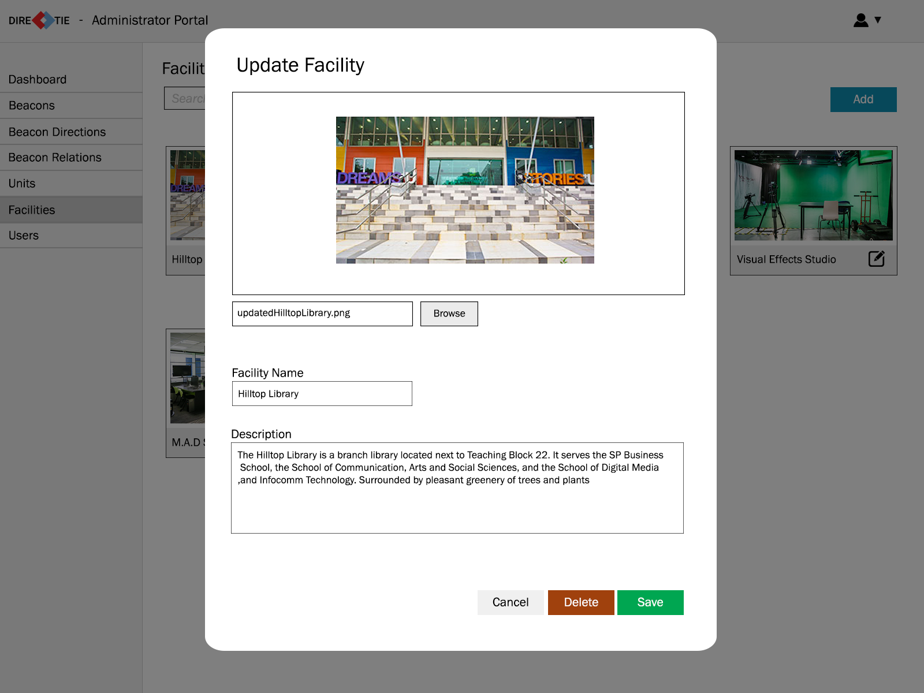
Manage
Facilities

Slide 45
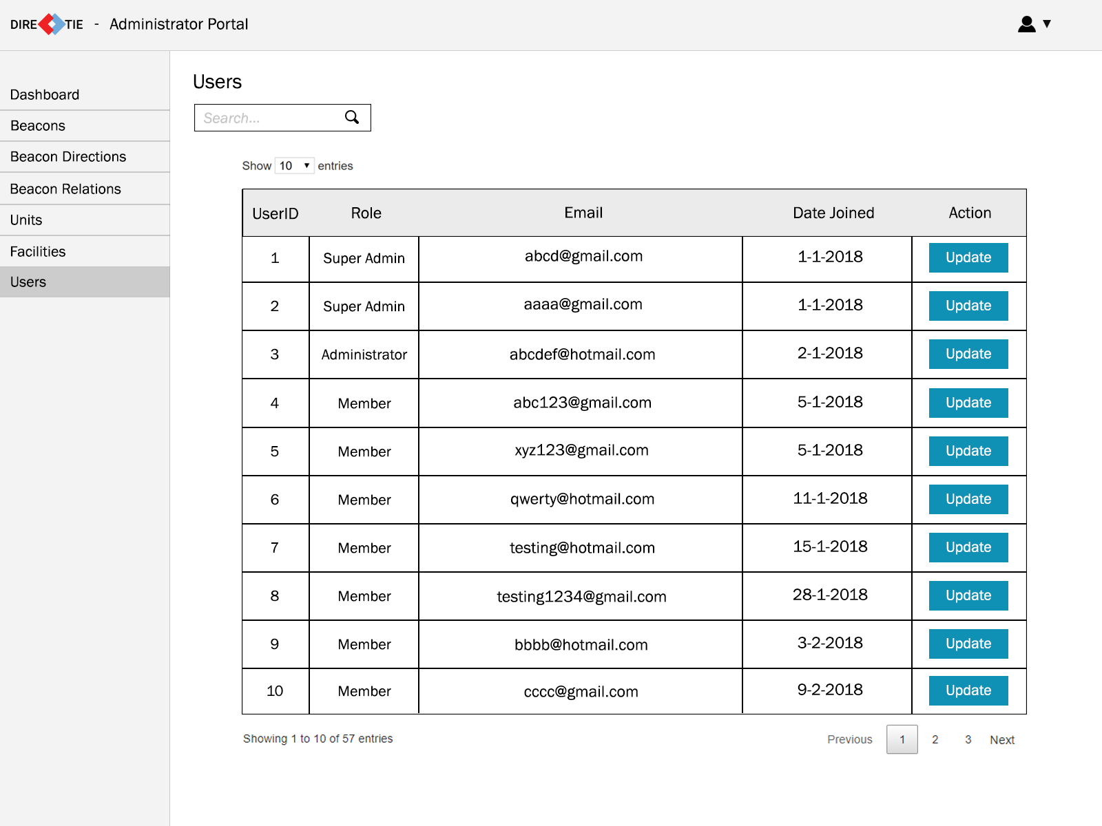
Manage
Users

Slide 46
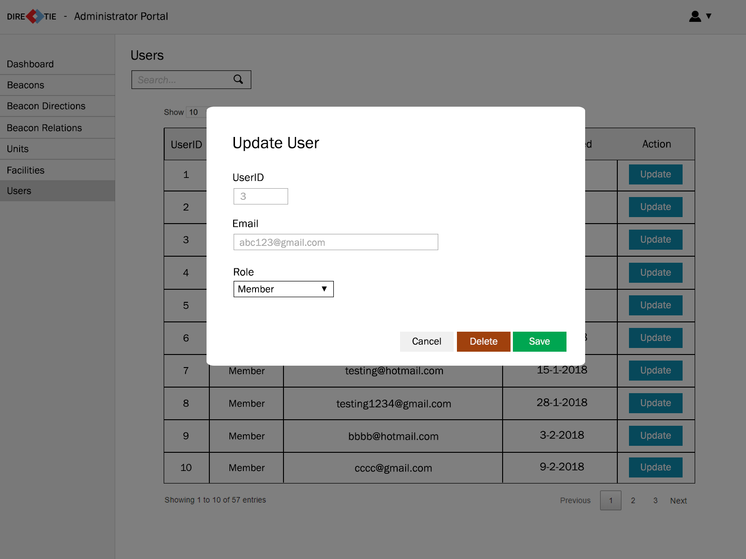
Update
User

Slide 47
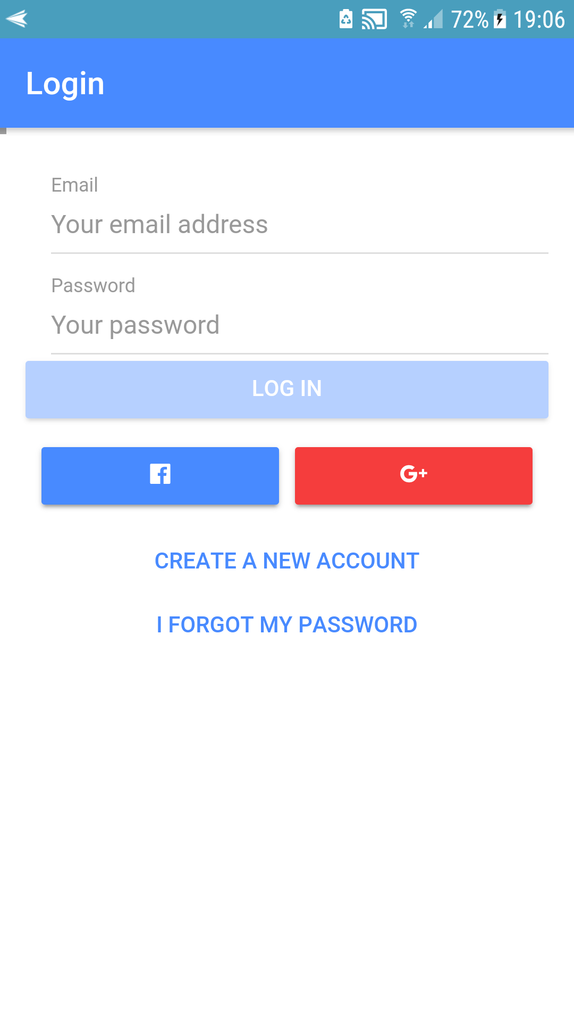
Flow of the app

Slide 48
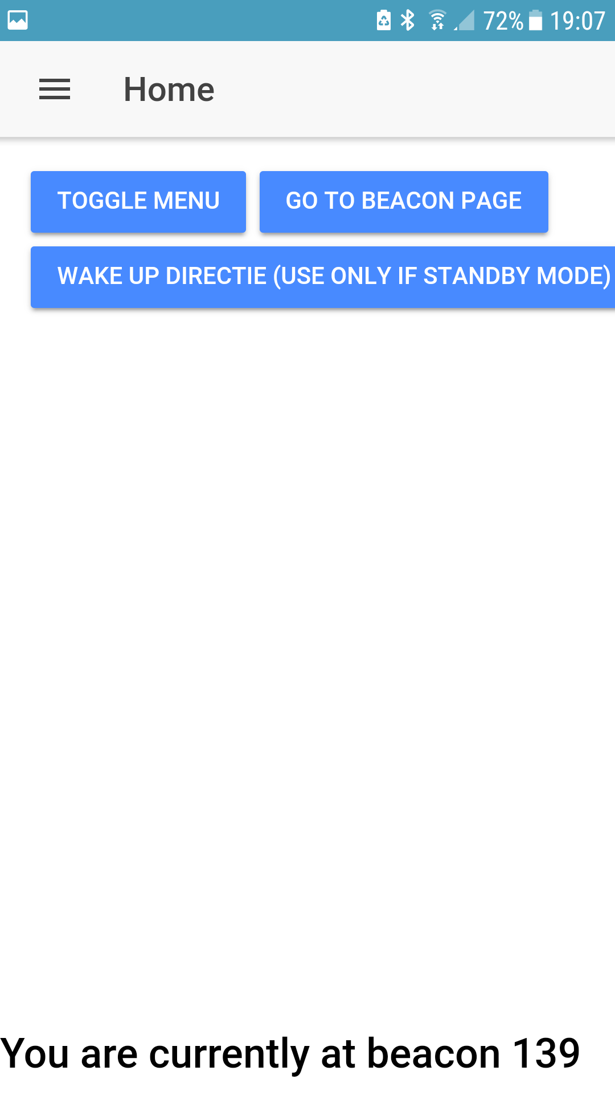
Flow of the app

Slide 49
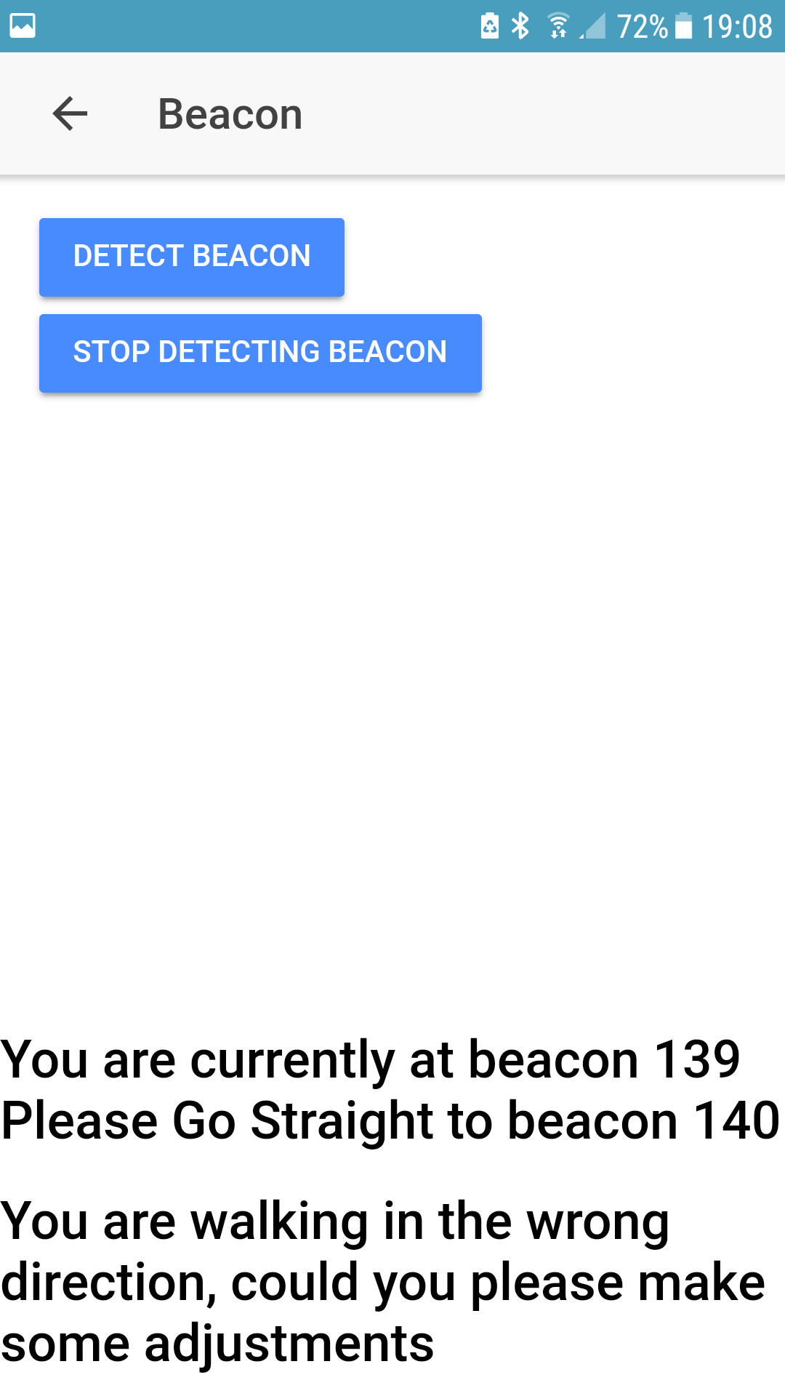
Flow of the app

Slide 50
Application Demonstration
Notes:
http://web.airdroid.com/

Slide 51
Questions?

Slide 52
Thank You

